Slide 1
Professionalism in the Workplace
Presented by: Dan Jacobi & Whitney Smith

Slide 2
Dress Code
Handbook Policy | Interpretation
“A student working in the capacity of an ATS must wear UWA Athletic Training Issued Apparel, UWA Sport Medicine Club apparel or apparel for a UWA Varsity Athletic team (shirts/pullovers).” “Shirts will be tucked in neatly at all times when performing duties as an ATS or when in the athletic training room for any reason (no exceptions).” | Shirts/Polo’s Acceptable attire includes: UWA or AT polos/game shirts UWA AT T-shirts SMC, NATA, SEATA, etc T-shirts UWA T-shirts in red, white, or gray Adidas shirts in red, white, or gray No rips, tears, holes, snags, frays or stains Game shirts must be worn during Physician’s Clinic, Game Days and/or clinical rotations at sites other than UWA (general medical rotations, surgeries, etc) All shirts must have sleeves and must be tucked in.

Slide 3
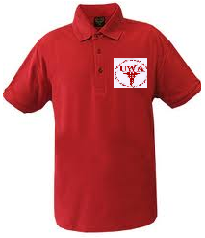

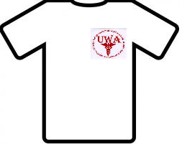

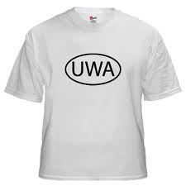

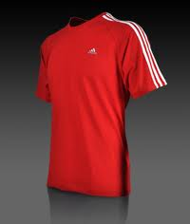
Correct vs. Incorrect

Slide 4
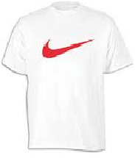
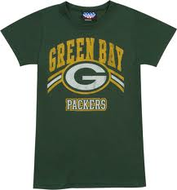
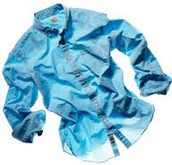

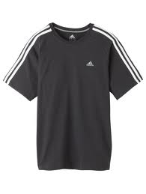

Correct vs. Incorrect

Slide 5
Dress Code
Handbook Policy | Interpretation
“Shorts/pants: Shorts must all be of appropriate length (standing straight up, tips of fingers must not pass hem of the shorts) and clean (no cutoffs, rips, or holes). Pants must be neat, of appropriate length, and style (wind-pants, khakis)” “Pants will be worn in an appropriate, and neat manner (waist of pants will be on the person’s waist, no cut off bottoms, or excess amounts of holes, etc).” | Shorts/Pants- In all circumstances, khaki shorts/pants are preferred when working in the athletic training room. Acceptable attire includes: Khaki dress pants or slight variation of khaki color (not khaki jeans) No army green, gray, blue black or printed khakis Gym Shorts/pants that are AT, UWA, Adidas, or plain in red/white/gray/black Khaki cargo shorts/pants will be acceptable for the remainder of this semester only. No sweatpants (unless UWA specifically), tights underneath shorts, pajama pants or scrubs No rips, tears, holes, snags, frays or stains

Slide 6
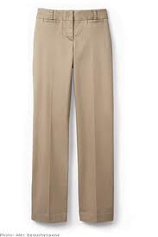
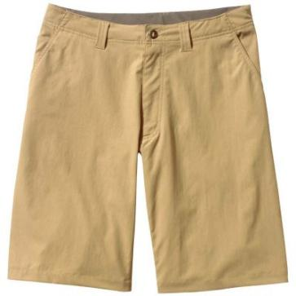
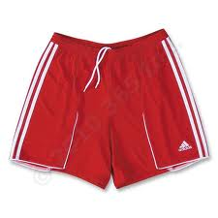
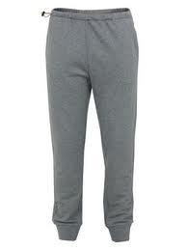
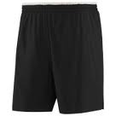
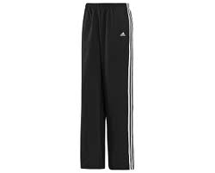
Correct vs. Incorrect

Slide 7
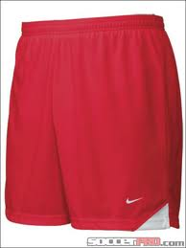
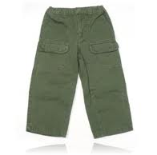
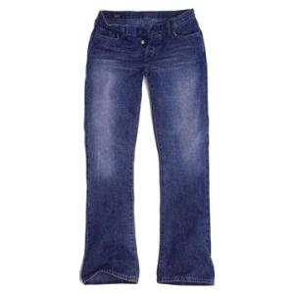
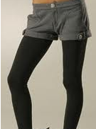
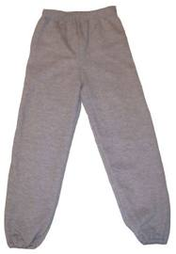
Correct vs. Incorrect

Slide 8
Dress Code
Handbook Policy | Interpretation
“All shirts must be of length to be able to be tucked into the shorts or pants; they must also have sleeves that cover over both shoulders.” “Game dress will be uniform (UWA athletic training polo shirt, khaki shorts/ khaki pants). The only variations to this game dress uniform will be in instances where the sport’s staff requests the ATS to “dress up” or other considerations are made by the ATSMC staff (all variations must be approved).” | Sweatshirts/Jackets Acceptable attire includes: AT jackets/sweatshirts UWA jackets/sweatshirts in red/white/gray/black Adidas jacket/sweatshirt in red/white/gray/black Plain (non-competitive brand) jacket/sweatshirt in red/white/gray/black No rips, tears, holes, snags, frays or stains

Slide 9
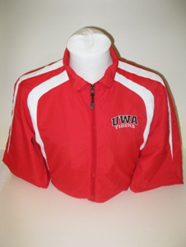
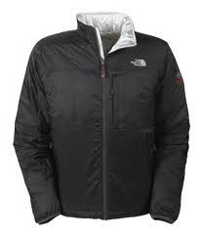
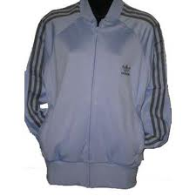
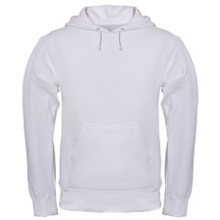

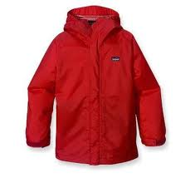
Correct vs. Incorrect

Slide 10
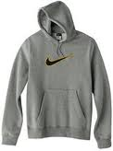
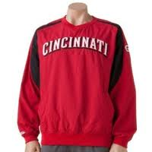

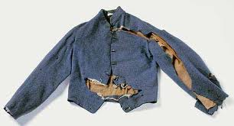
Correct vs. Incorrect

Slide 11
Dress Code
Handbook Policy | Interpretation
“At all times, shoes worn in the athletic training room must be closed toed and closed backed (no sandals or flops will be worn).” | Shoes Adidas or non-competitive brand only Dress shoes (functional for running) are permitted with appropriate attire ALL shoes must be closed toe and closed heel No flip-flops, sandals, slippers, etc.

Slide 12
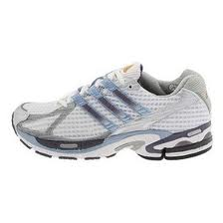
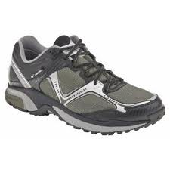
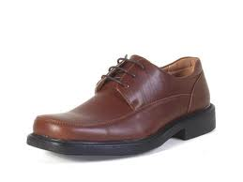
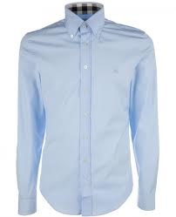

Correct vs. Incorrect

Slide 13
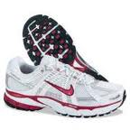
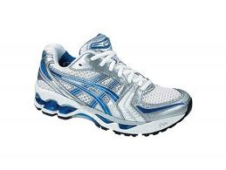
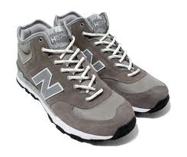
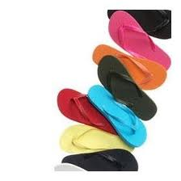
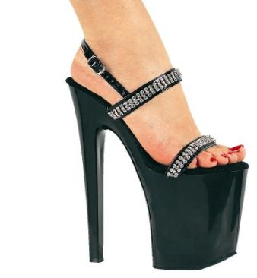
Correct vs. Incorrect

Slide 14
Dress Code
Handbook Policy | Interpretation
“Earrings on male students are unacceptable. Females may wear earrings if appropriate (may not be long or dangling).” “ Visible body piercings will not be allowed.” “Jewelry (necklaces, bracelets, watches, rings, etc) must not interfere with the proper delivery of patient care.” “Hats may be worn “front-wards” and must be neat and clean. They will not display vulgar, obscene/offensive images nor display logos of other universities.” | Socks/Sunglasses/Hats/Piercings Athletic Training, UWA, Adidas or non-competitive brand only No hats, sweatshirt hoods, beanies (toboggans) or sunglasses are to be worn in Athletic Training Facility (JH 216 & PH 32) No multicolored, printed socks that are visible ALL facial piercing must be removed while on duty, and/or before entering the Athletic Training Facilities No male ear piercings allowed while on duty. No bandanas or “doo-rags” allowed at any time

Slide 15



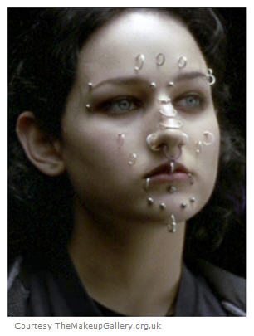
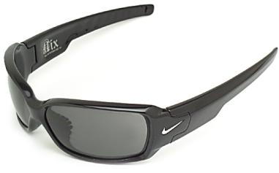
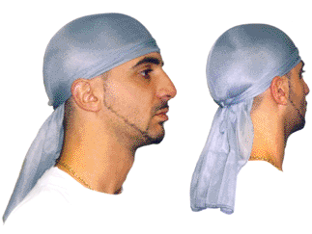
Correct vs. Incorrect

Slide 16
Dress Code
Handbook Policy | Interpretation
“Hairstyles should be neat and maintained. For males, hair may not extend below the shirt collar and facial hair must be kept neatly trimmed. Facial hair should be kept to a minimum or neatly trimmed if having a moustache or beard. Make it a point to be cleanly shaven (no stubble), especially at athletic events, physicals, or on doctor’s visits. For females with long hair, it must be pulled back/put up in a neat and functional fashion.” | Current policy is in effect.

Slide 17
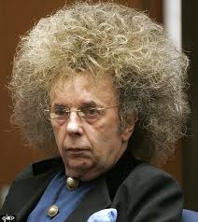


Correct vs. Incorrect

Slide 18
Please understand that…
The ultimate decision on the attire or appearance being appropriate for the ATS to carry out clinical assignments is at the discretion of the ACI supervising the student at the respective venue. In the event of a disagreement between the ACI and the ATS, the ultimate decision will be deferred to the Head Athletic Trainer, Associate Athletic Trainer, and/or the Program Director. | No apparel affiliated with high schools, other colleges, professional teams, or any other team/organization other than UWA will be worn in the ATR or when working as an athletic training student at other venues.

Slide 19
Attendance
Handbook Policy | Interpretation
“A student enrolled in the ATEP is required to attend and actively participate in all scheduled/assigned clinical experiences.” “Athletic training students may occasionally be absent from clinical assignments… In these instances students are encouraged to provide advance notice to all their supervising ACI/ATCs” | Your clinical assignments are just like a job. You should not miss just because you want to go do something else instead. We understand there are situations where you will not be able to be here. However, please let us know as soon as possible so other arrangements can be made to cover for you.

Slide 20
Attendance
Handbook Policy | Interpretation
“Records of absences and tardies will become a part of the student’s permanent record. Any student who is tardy or absent from assigned clinical experiences will be reprimanded by the following guidelines: T:\Whitney Smith\Absence Record.docx | Each ACI will keep track of their individual student’s absences. A record of these absences will be filed in the student’s chart at the end of the semester Additionally, every two tardies will count as one absence. However, it is at the discretion of the supervising ACI as to what will be considered tardy vs. absent. ie: if a student arrives 45 minutes late, the ACI may choose to count them absent rather than just tardy

Slide 21
Absence Policy
First Absence: the student will receive a warning and the policy will be reiterated to them.
Second Absence: the student will be assigned an additional one week rotation in morning treatment/rehabilitation.
Third Absence: the student will be suspended from clinical experiences for 1 calendar week. At no time will the student be allowed to participate in any athletic training events or clinical experiences on campus during this week.
Fourth Absence: the student will be removed from primary sport(s) assignments and fulfill all clinical experience hours within the Athletic Training Facility at hours approved by the ATEP staff.
Fifth Absence: the student will be removed from all clinical experiences and fail their clinical experiences course
In all cases a record of this negligence will be placed in the student’s permanent folder which will factor in to consideration for continuance in the program.”

Slide 22
Punctuality
Handbook Policy | Interpretation
“Students are expected to be ready to initiate the clinical assignment at the designated time. Those students not ready, including appropriate dress and equipment, to initiate the clinical assignment as described will be considered tardy.” “Students should be where assigned on time or early. If anything, be five minutes early.” “When anticipating arriving late, call immediately.” | Be ready to work at the time your ACI has designated for you to be there. Plan to eat, change clothes, etc, ahead of time so that you are ready to work when you walk in. Athletes often arrive early. You should be there before they arrive. If we do not know about it, you will be considered absent/tardy.

Slide 23
Professional Conduct
Handbook Policy | Interpretation
““Personal business should not be conducted in the athletic training room. This can and will hamper the function of the staff or patient/athlete care.” | No computers shall be used for purposes other than athletic training related (i.e. Facebook, Youtube, personal email) Cell phones, music players, etc fall into this category. At no time will students use these devices while on duty. This includes texting. If you absolutely have a need to use your cell phone, make sure your responsibilities are covered and ask to be briefly excused. Your cell phone should not be seen or heard except in extenuating circumstances. Period.

Slide 24
Professional Conduct
Handbook Policy | Interpretation
“While in the athletic training room, or at UWA varsity practices and games, the use of profanity, horse play, or unacceptable behavior to the allied health care professional, will not be tolerated.” | No tobacco use in the Athletic Training Facility No sitting or lying down on the treatment tables unless otherwise instructed Inappropriate, non-athletic training related conversations shall not be permitted in the Athletic Training Facility or at team practices, games, etc.

Slide 25
Exceptions
Rodeo | Other Sports
Athletic trainers and athletic training students may choose to wear other appropriate apparel while at the rodeo arena or while in preparation for practice/rodeo events. Appropriate apparel includes: Blue jeans Boots Hats/Caps Belt buckles Collared shirts Or any of the aforementioned acceptable attire | Other sports may choose to wear other apparel as deemed appropriate by the supervising ACI When assigned to the ATR as a clinical rotation, or when getting extra hours by working in the athletic training room, khaki shorts/pants are required.

